Slide 1
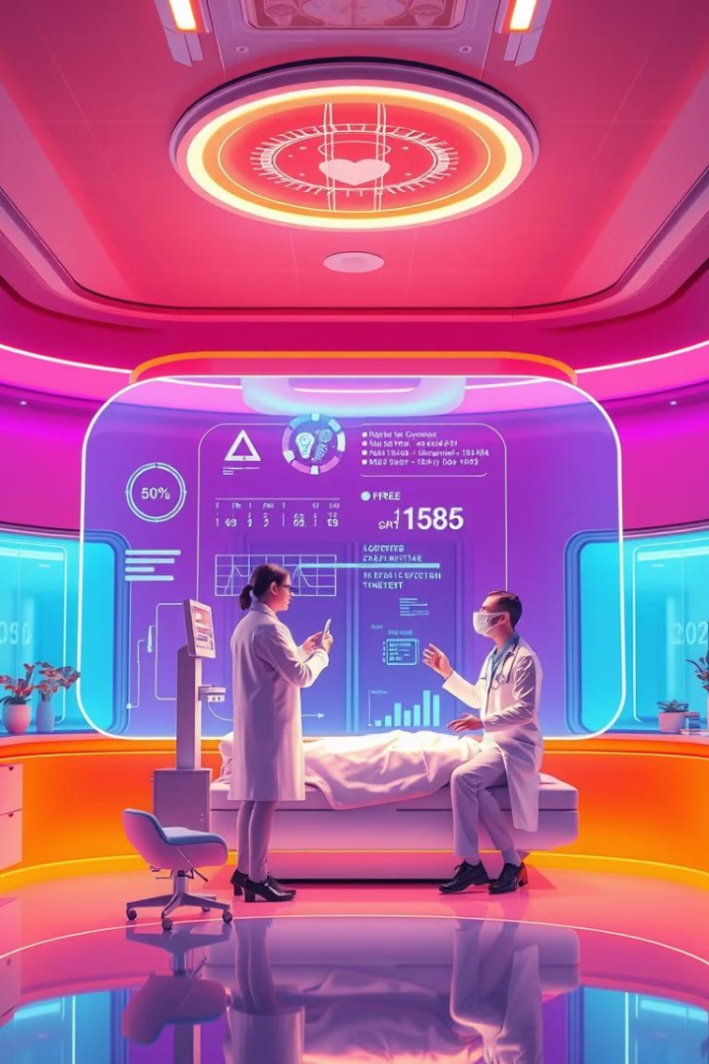

AI-Powered Patient Profile Management Platform
Empowering patients, enabling doctors, transforming healthcare.
by SAI CHARAN S

Slide 2
The Challenge in Healthcare
Scattered Records
Limited Access
Manual Inefficiencies
Lack of Control
Patients often have disorganized and incomplete medical records. This can be a major challenge when trying to track their health history or share information with healthcare providers.
Doctors often lack standardized access to a patient's complete health history. This can lead to misdiagnosis and unnecessary tests, wasting time and resources.
Manual data entry of prescriptions and other medical information is time-consuming and error-prone. This can lead to delays in treatment and potential medical errors.
There is no streamlined way to provide controlled and secure access to medical information, making it difficult for patients to share their health data with trusted healthcare providers.

Slide 3

Our Solution: The Patient-Centric Health Platform
1
Centralized Patient Profiles
2
AI-Powered Data Extraction
Our platform provides a centralized location for patients to store prescriptions, diagnoses, and medical history. This eliminates the need for scattered paper records.
The platform uses AI to extract prescription data from images or PDFs, eliminating manual data entry and reducing errors.
3
Secure Access Control
4
Health Insights and Reminders
Patients can grant doctors temporary, controlled access to their medical records via secure links. This ensures patient privacy while facilitating seamless information sharing.
The platform provides patients with personalized health insights, reminders for medication and appointments, and emergency access options to support proactive health management.

Slide 4
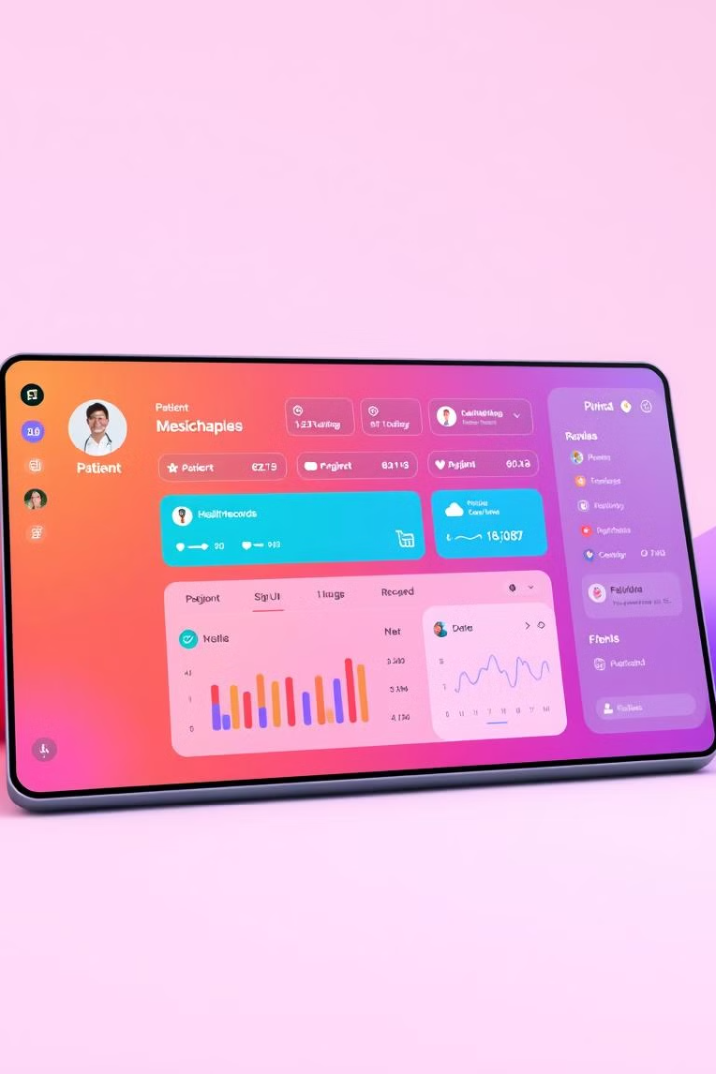




What Sets Us Apart
Patient Control
Secure Access
Patients have complete control over their medical records and decide who can access them. This promotes patient autonomy and empowers individuals to manage their health information.
Temporary, expirable access URLs ensure that only authorized healthcare providers can view a patient's medical information. This safeguards patient privacy and prevents unauthorized access.
AI Integration
Health Reminders
AI-based data extraction automates the process of uploading prescriptions and medical documents, saving time and effort for both patients and doctors.
The platform provides personalized reminders for medication, appointments, and other health-related tasks to help patients stay on track with their healthcare needs.

Slide 5
How It Works
Upload
Patients upload prescription images or PDFs to the platform. The platform is designed to be user-friendly and intuitive, allowing for seamless document uploads.
Secure Storage
The extracted data is stored securely in a database aligned with global disease standards, ensuring data integrity and accessibility for authorized users.
1
2
3
4
AI Processing
Doctor Access
The AI analyzes the uploaded documents using OCR and NLP to extract key details like medication names, dosages, and diagnosis codes. The AI is trained on a vast dataset of anonymized prescription data to ensure accuracy and efficiency.
When a doctor needs to access a patient's medical records, they request access through the platform. Patients approve the request, granting temporary access to their information through a secure link.

Slide 6



Leveraging AI for Healthcare
OCR
1
Optical Character Recognition (OCR) technology enables the platform to extract text from images or PDFs, converting them into digital data.
NLP
2
Natural Language Processing (NLP) algorithms are used to interpret medical terms and understand the context of medical information within the uploaded documents.
Machine Learning
3
The platform's AI model is trained on a large dataset of anonymized prescription data, allowing it to learn patterns and improve its accuracy in data extraction.

Slide 7
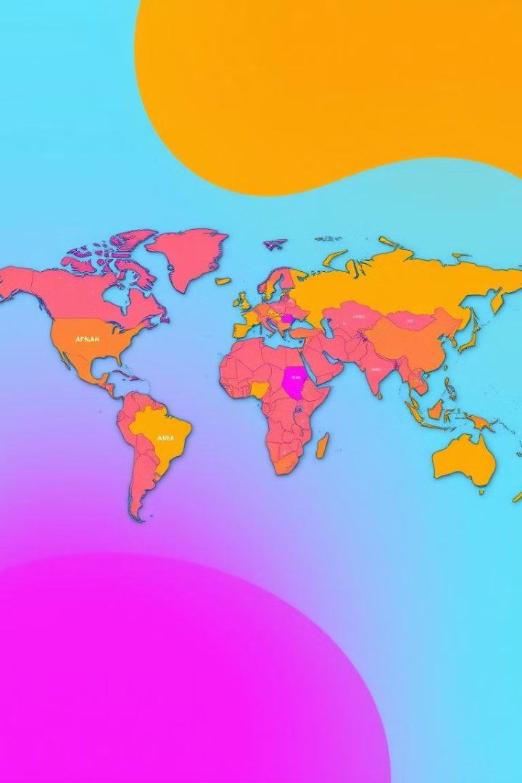
Impact and Scalability
X%
X%
Patient Need
Doctor Demand
A significant percentage of patients struggle to maintain accurate and organized medical records, highlighting the need for a solution like our platform.
A substantial portion of healthcare professionals need better record-sharing systems to streamline patient care and improve communication.
X%
Market Growth
The digital health market is experiencing rapid growth globally, fueled by advancements in technology and increasing adoption of digital healthcare solutions.

Slide 8
Why Choose Us?
Competitors
1
Existing solutions are often limited by manual data entry, lack of patient control, and insecure information sharing.
Our Platform
Our platform leverages AI for seamless data extraction, empowers patients with control over their information, and ensures secure doctor interaction, providing a comprehensive and efficient solution.
2

Slide 9
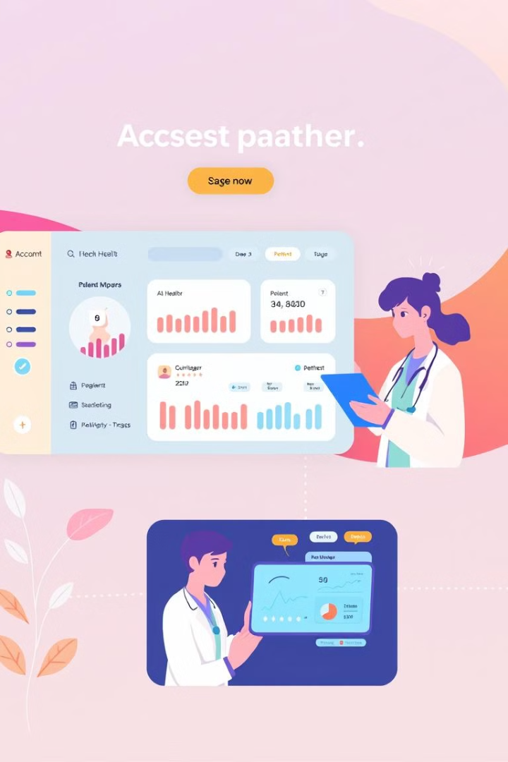
Transforming Healthcare Together
Join us in making healthcare smarter, simpler, and patient-centric. Thank You!

